Slide 1

Financial Workflow Automation System
Python, SQL, Power BI | Aug 2024 – Dec 2024

Slide 2
Project Objective
This project automates financial reporting using Python, enabling monthly KPI tracking like income, expenses, net income, and profit margin. It streamlines manual workflows and helps finance teams make data-driven decisions.

Slide 3
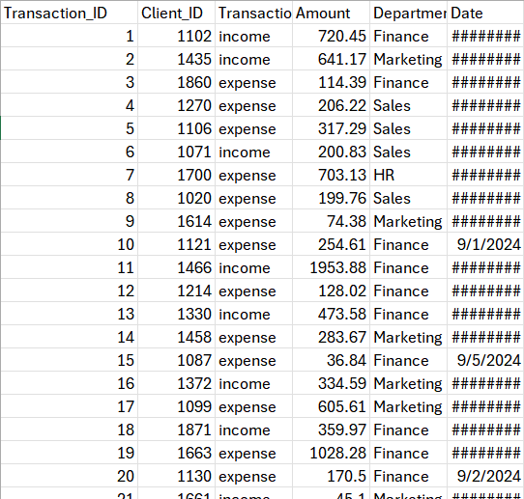
Dataset Summary
6,000 transactions simulated
Fields: Transaction_ID, Client_ID, Amount, Type, Department, Date
Transactions from Jul to Dec 2024 across departments: Sales, Marketing, HR, Finance

Slide 4
KPI Calculation Logic
Monthly income and expenses grouped by Department
Net_Income = Income - Expense
Profit_Margin = Net_Income / Income × 100
Visualized using bar and line plots

Slide 5
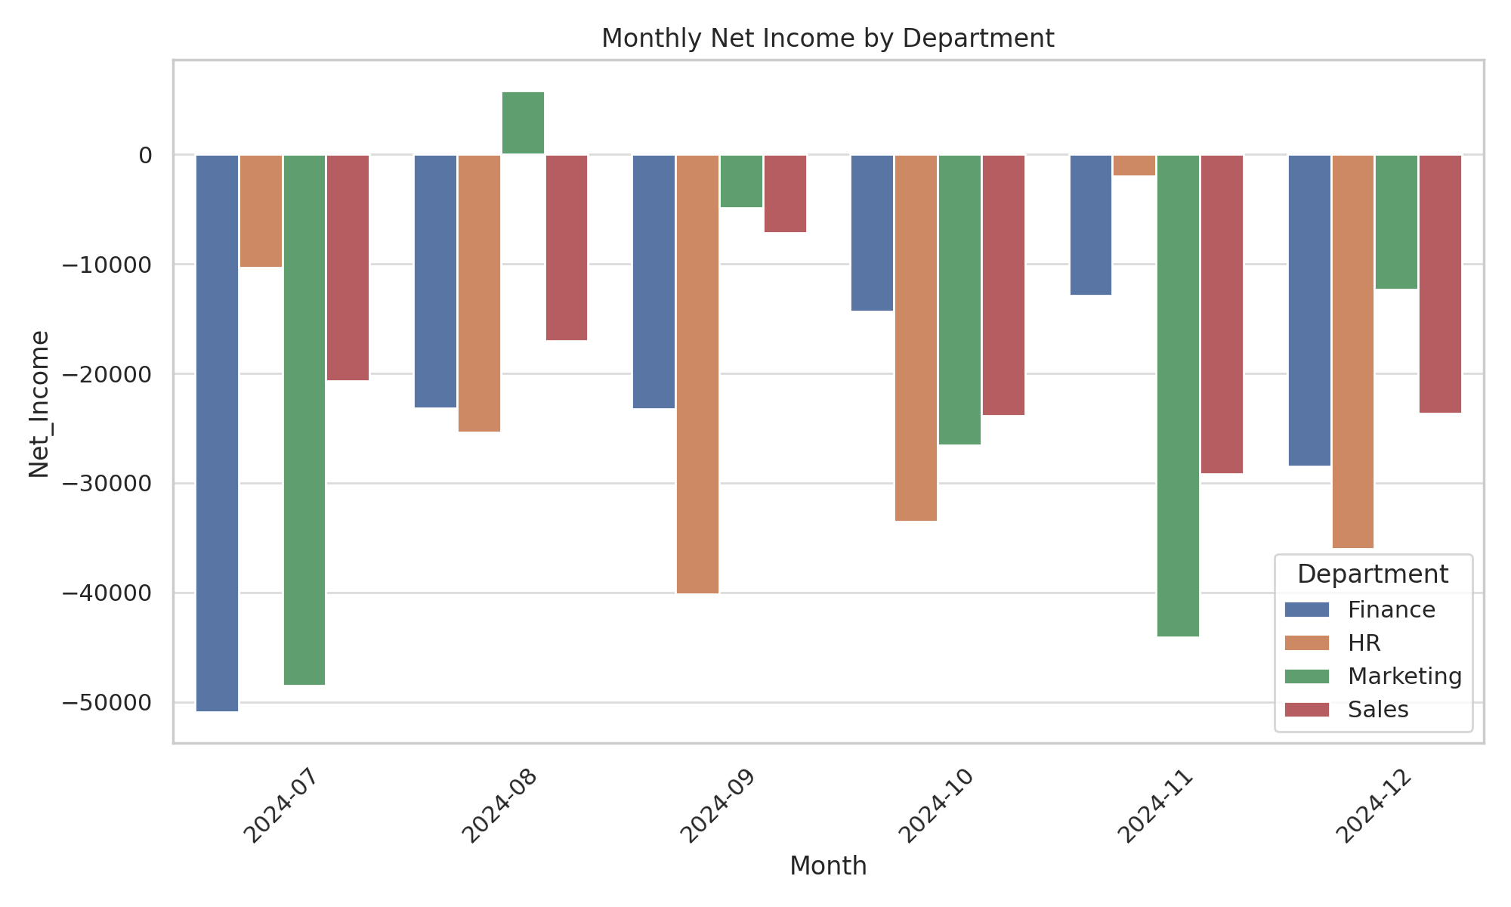
Monthly Net Income by Department

Slide 6
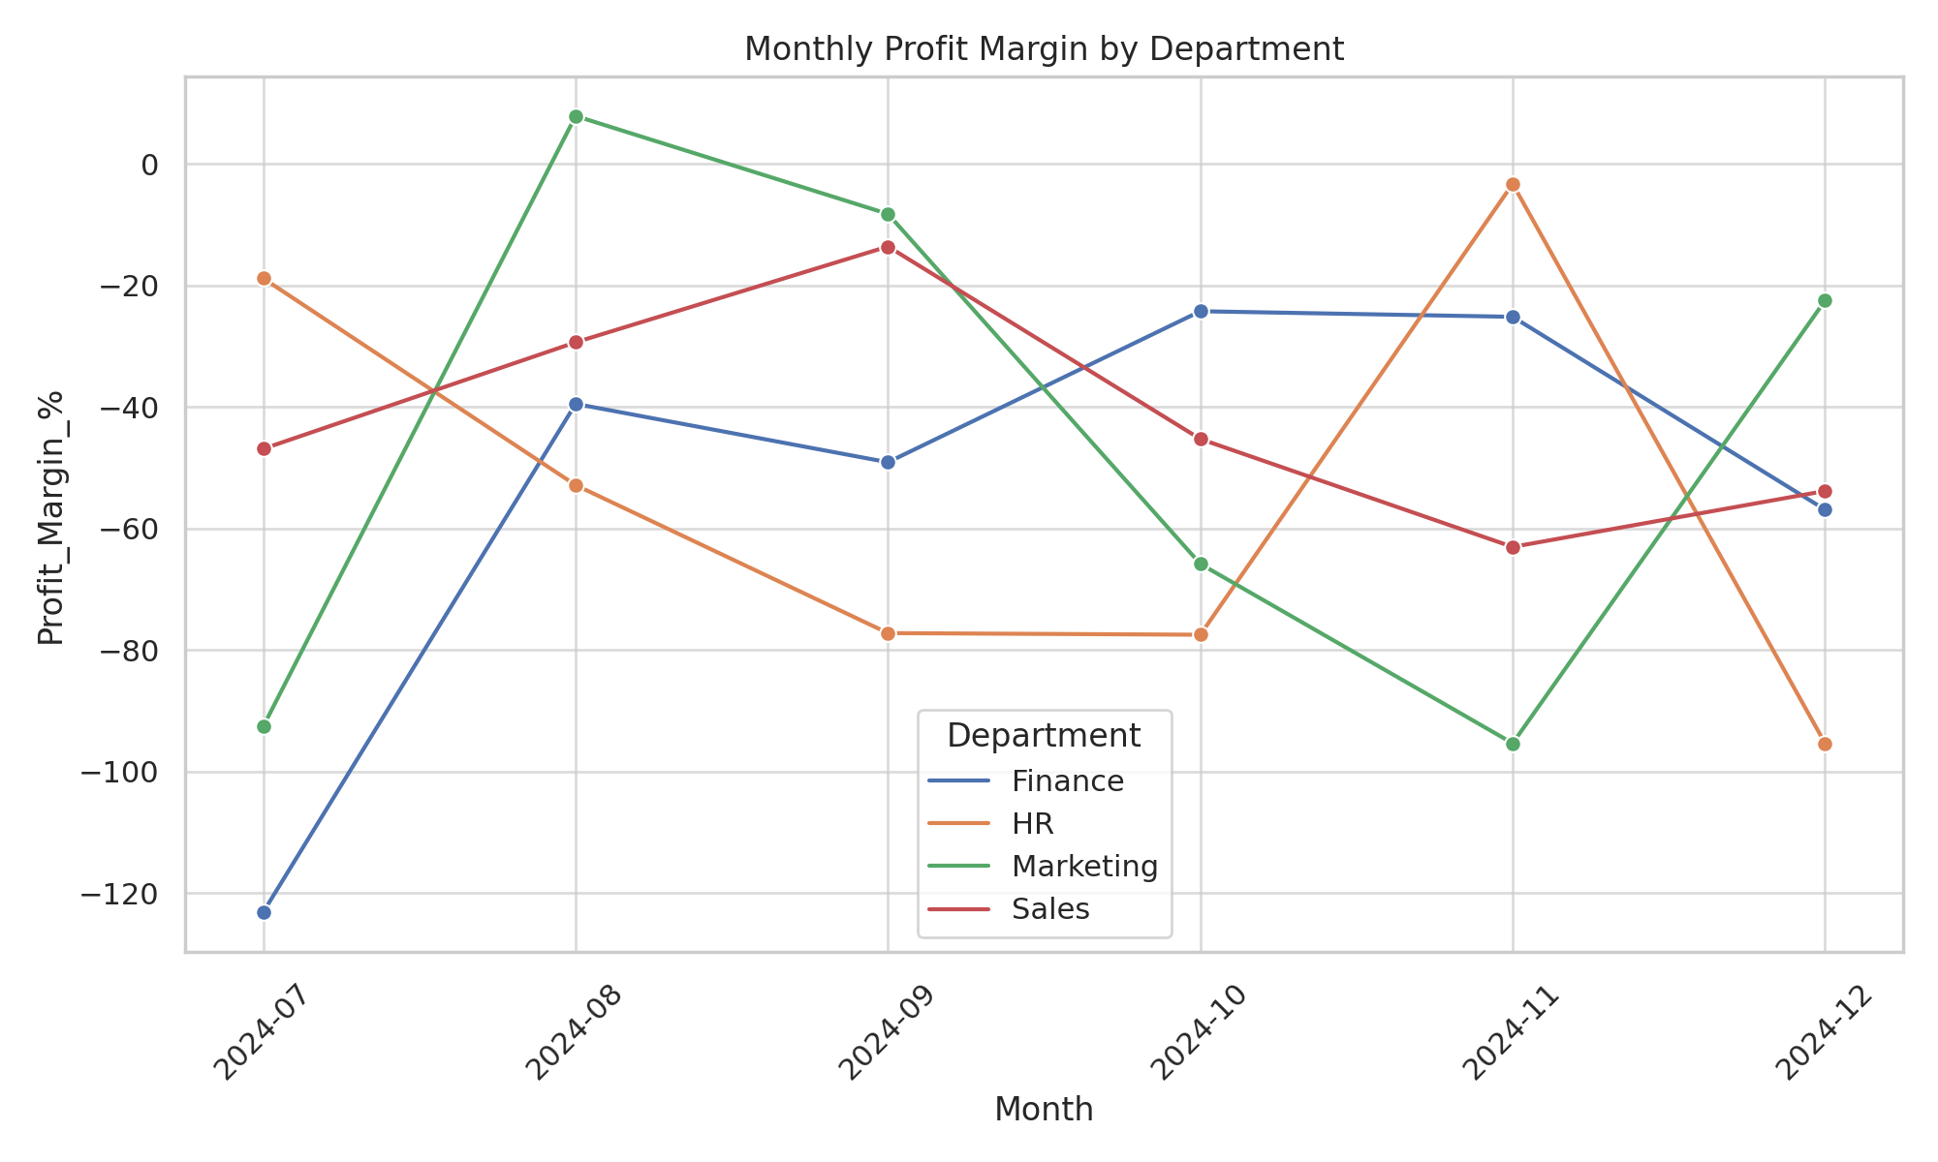
Monthly Profit Margin by Department

Slide 7
Conclusion
The system automates KPI reporting and reduces manual work
Insights into department-level performance enable better financial planning
Can be extended using SQL backends and Power BI dashboards for real-time reporting

